Slide 1


LangChain
Group 6
Anna Niedermeyer, Anshu Mehta, Dhiraj Patel, Mehulkumar Patel, & Olivia Boe

Slide 2

Agenda
An Overview of LangChain
Components of LangChain
How does LangChain work for you?
The Front End - An Overview
Use Cases and Examples

Slide 3
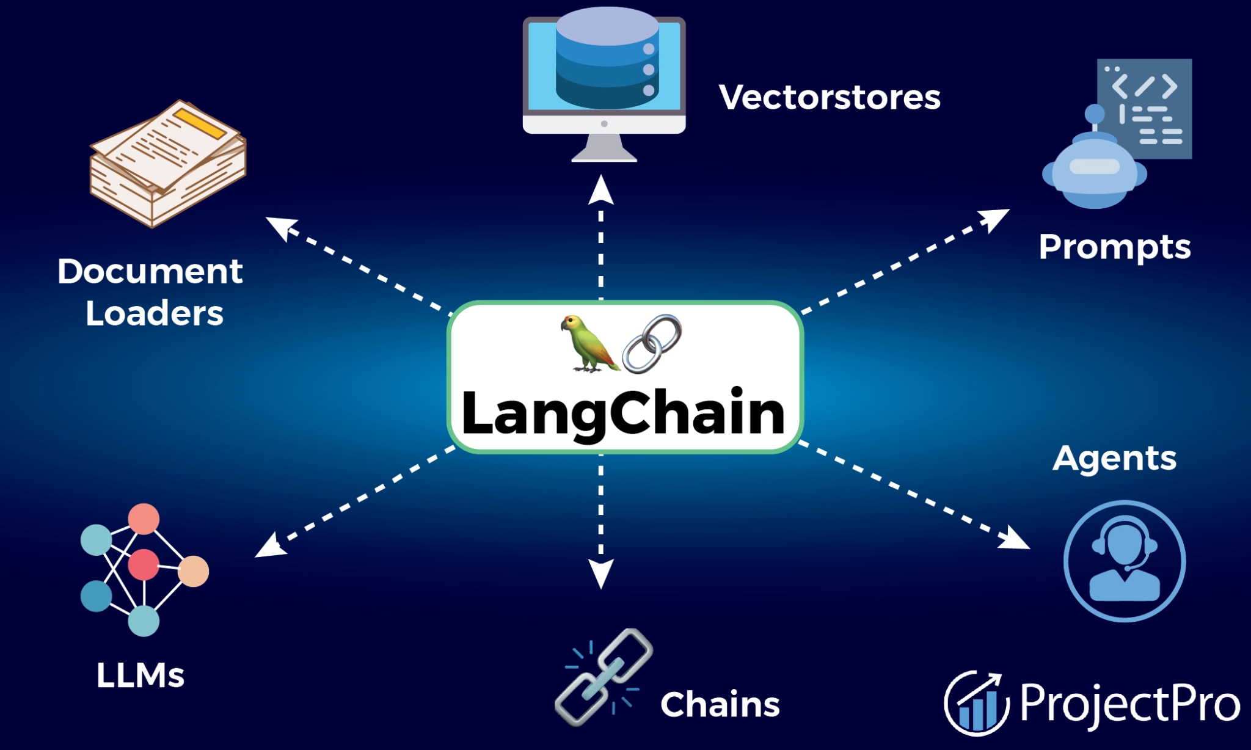
An Overview of LangChain
What is LangChain?
An open source framework based on large language models (LLMs) and can generate responses to user queries
What does LangChain do?
Enhances how language models can interact with data and external systems
Smarter querying:
Translates natural language into SQL queries
Knowledge base search:
Queries documents or databases and generates readable summaries
API Interactions:
Seamless integration with APIs to fetch data dynamically from user input

Slide 4

Components of LangChain
Chains
Agents
Tools
Memory
A chain is a linear series of automated tasks derived from the user’s query
Automates tasks through linking
Chains are made up of links. Where each task in a chain gets broken into even smaller pieces called links
Agents use language models to decide which tool to use to fulfill the task
A more flexible and dynamic version of a chain
More suitable for complex tasks requiring real-time decisions
External systems or functions for the language model to call
Examples:
Custom Python functions
APIs
SQL Databases
Document loaders and receivers
File Processors
AI Models
Maintains the context during interaction across multiple queries
It supports:
Simple memory systems that recall recent conversations
Complex memory structures that analyze historical data to return most relevant results

Slide 5




How can LangChain Work for you?
Streamline Queries:
Easy for Anyone to use:
Automate Data Pipelines:
Automatically fetch data from databases, clean it, and run analysis in a single workflow
Integrate your databases and APIs
Intuitive interfaces for easy setup and seamless workflows
No need to write complicated queries, simply ask LangChain a question, and it will handle the query for you
Automate complex data tasks, from data ingestion to analysis and reporting
Chain data extraction, transformation, and reporting tasks together, saving time and reducing manual work
User
LangChain
Database
Final Output
Notes:
Lets find another prompt for 2nd one Helps different levels of users - tech and non-tech users

Slide 6
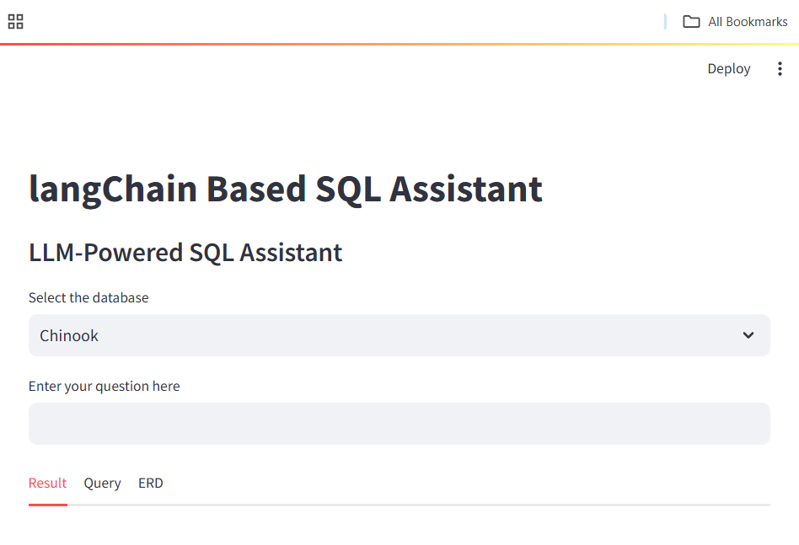
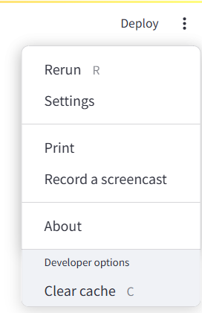
Front End Instructions
Step 1: Select your database
Step 2: Evaluate the ERD map
Step 3: Enter your question
Step 4: Evaluate your result
Step 5: Review your query
Step 6: Rerun or rephrase your question if needed

Slide 7
LangChain:Use Cases

Slide 8
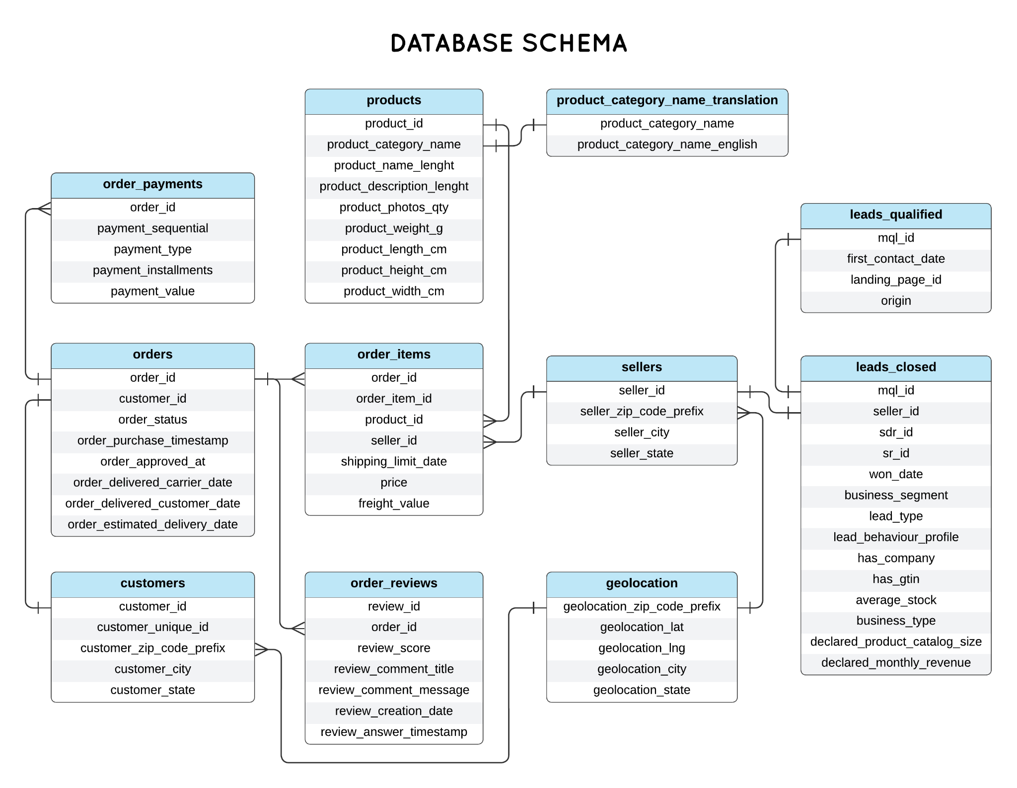
E
C
O
M
M E
R
C
E
E
R
D

Slide 9
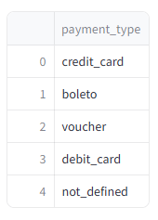
E-Commerce Use Case
Scenario: We have a new head of business development, let’s review all the payments types we accept.
Prompt: What are the different payment types used in the orders?
Query: SELECT DISTINCT payment_type
FROM order_payments;

Slide 10
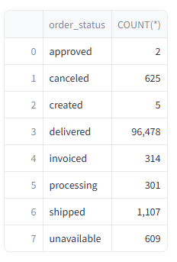
E-Commerce Use Case
Scenario: Let’s find how many orders we receive for each status. We want to track sales and customer satisfaction.
Prompt: How many orders are there for each order status?
Query: SELECT order_status,
COUNT(*)
FROM orders
GROUP BY order_status;

Slide 11
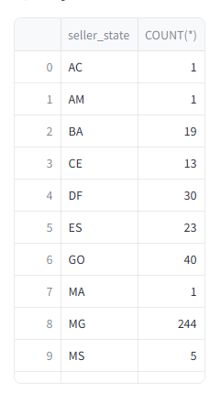
E-Commerce Use Case
Scenario: We are thinking of building a new office, let’s find out where all our sales employees are located.
Prompt: How many sellers are there in each state?
Query: SELECT seller_state,
COUNT(*)
FROM sellers
GROUP BY seller_state;

Slide 12
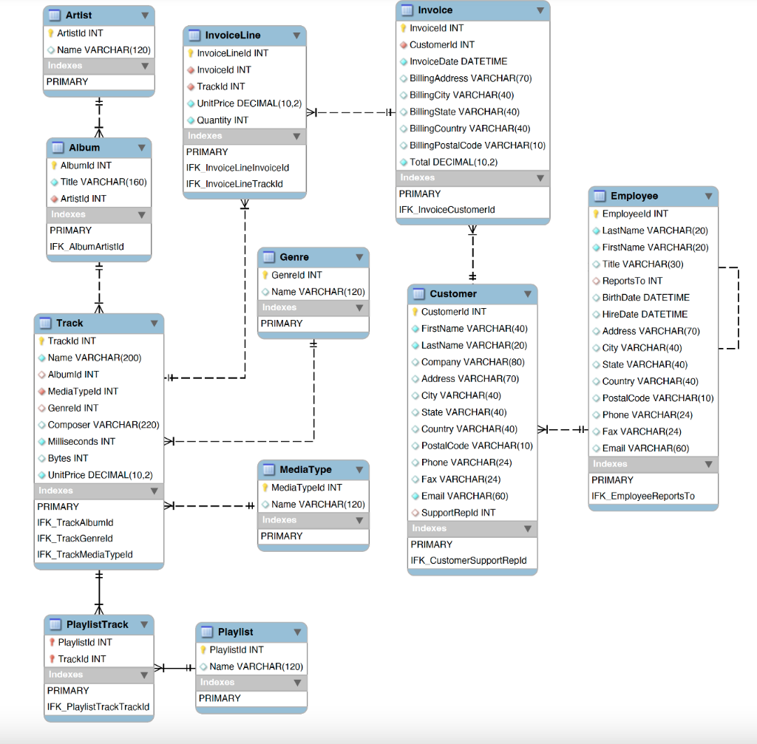
Chinook ERD

Slide 13
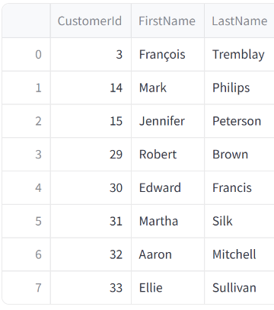
Chinook Use Case
Scenario: Our shipment to Canada got delayed, Jerry needs a list of all our Canadian customers to send customer discounts on future orders.
Prompt: I want a list of all customers from Canada
Query: SELECT *
FROM Customer
WHERE Country = 'Canada';

Slide 14
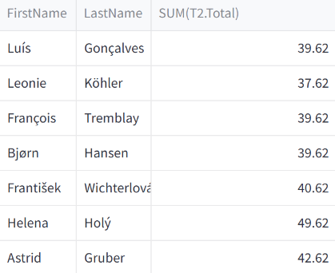
Chinook Use Case
Scenario: We want to know how much our customers are spending on albums.
Prompt: Give me customer names and their invoice amount for all invoices for all customers
Query: SELECT T1.FirstName,
T1.LastName,
SUM(T2.Total)
FROM Customer AS T1
JOIN Invoice AS T2 ON T1.CustomerId = T2.CustomerId
GROUP BY T1.CustomerId;

Slide 15
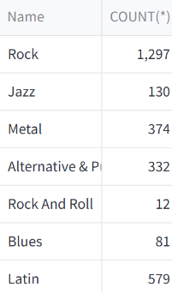
Chinook Use Case
Scenario: We want to know what the most common genre is in our inventory to stock up on new material.
Prompt: Return genre names and a count of all tracks from tracks.
Query: SELECT T2.Name,
COUNT(*)
FROM Track AS T1
JOIN Genre AS T2 ON T1.GenreId = T2.GenreId
GROUP BY T1.GenreId;

Slide 16

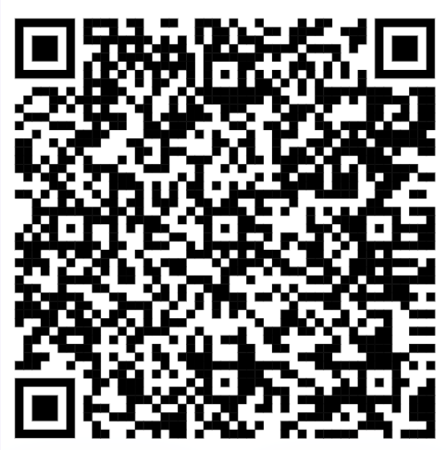
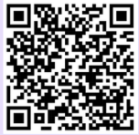
More Information
More Use Cases:
Our Flyer:
More Info:
Anna Niedermeyer
(niede098@umn.edu)
Olivia Boe
(boe00024@umn.edu)
Dhiraj Patel
(pate1525@umn.edu)
Mehulkumar Patel
(pate1526@umn.edu)
Anshu Mehta
(mehta395@umn.edu)

